Slide 1

🌱 Introduction to Spring Boot Framework (Java)
Presented by: R.a.mohan Tiwari & Namrata Bastola

Slide 2




What is Java?
High-Level OOP
Write Once, Run Anywhere
Object-oriented programming language with intuitive syntax and powerful features.
JVM enables cross-platform compatibility across all devices and operating systems.
Robust & Secure
Automatic memory management and built-in security features protect your applications.

Slide 3
More Java Features
Beyond its core strengths, Java offers additional powerful features that make
it a versatile and widely adopted language.
Multithreading
Execute multiple parts of a program concurrently,
improving performance and responsiveness for complex applications.
High Performance
Just-In-Time (JIT) compilers and efficient garbage collection contribute to
Java's strong performance capabilities.
Distributed Nature
Designed for distributed computing, Java provides robust networking
libraries that facilitate creating distributed applications.

Slide 4



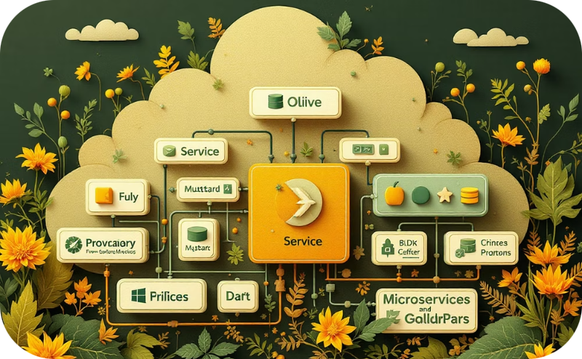
Spring Framework Overview
Component Management
Extensibility & Modularity
Web & API Development
Data & Microservices
It simplifies interactions with various databases and supports developing small, independent, and deployable services for microservices architecture.
Spring manages object creation and lifecycle through Inversion of Control (IoC) and provides dependencies via Dependency Injection (DI), promoting loose coupling.
Aspect-Oriented Programming (AOP) separates cross-cutting concerns like logging, while the modular structure allows developers to use only necessary parts.
Spring is ideal for building robust, scalable enterprise web applications and creating powerful, efficient RESTful web services.

Slide 5
What is Spring MVC?
Spring MVC (Model-View-Controller) is a powerful and flexible web framework built on the core Spring Framework. It provides a robust architecture for developing web applications and RESTful APIs, promoting clear separation of concerns and ease of development.
Clear Separation of Concerns
Flexible View Resolution
Annotation-Driven Development
Supports various view technologies like JSP, Thymeleaf, FreeMarker, and more, allowing developers to choose the best fit for their presentation layer.
It separates the application logic into distinct Model, View, and Controller components, making the codebase more organized and easier to maintain.
Leverages annotations (e.g., @Controller, @RequestMapping) for concise and readable code, reducing XML configuration.
Powerful Data Binding & Validation
Integrates Seamlessly with Spring Ecosystem
Offers robust mechanisms for binding HTTP request parameters to Java objects and validating user input, ensuring data integrity.
Being part of the Spring Framework, it integrates effortlessly with other Spring modules like Spring Data, Spring Security, and Spring Boot.

Slide 6






What is Spring MVC?
View
Presents data to users. Renders the UI and displays information from the Model.
Model
Contains application data and business logic. Interacts with the database and processes information.
Controller
Handles user requests. Routes traffic and coordinates between Model and View components.

Slide 7

Spring MVC Benefits
Clean Architecture
Separation of concerns makes code organized and maintainable. Modular design improves workflow.
Enhanced Testability
Independent components are easier to test. Mock objects simulate dependencies for thorough testing.
REST API Support
Built-in tools for creating RESTful services. Annotations simplify API development.
View Flexibility
Support for multiple view technologies. Easily integrate Thymeleaf, JSP, or other template engines.

Slide 8

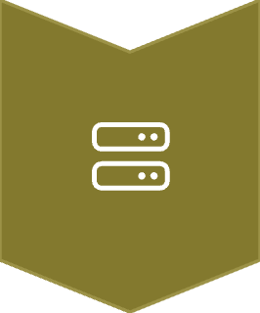



Spring MVC Flow Diagram
User Request
Browser sends HTTP request to application server.
DispatcherServlet
Central servlet receives all requests and routes them.
HandlerMapping
Maps request to appropriate controller method.
Controller
Processes request and returns Model and View objects.
ViewResolver
Locates and renders the correct view for the user.

Slide 9
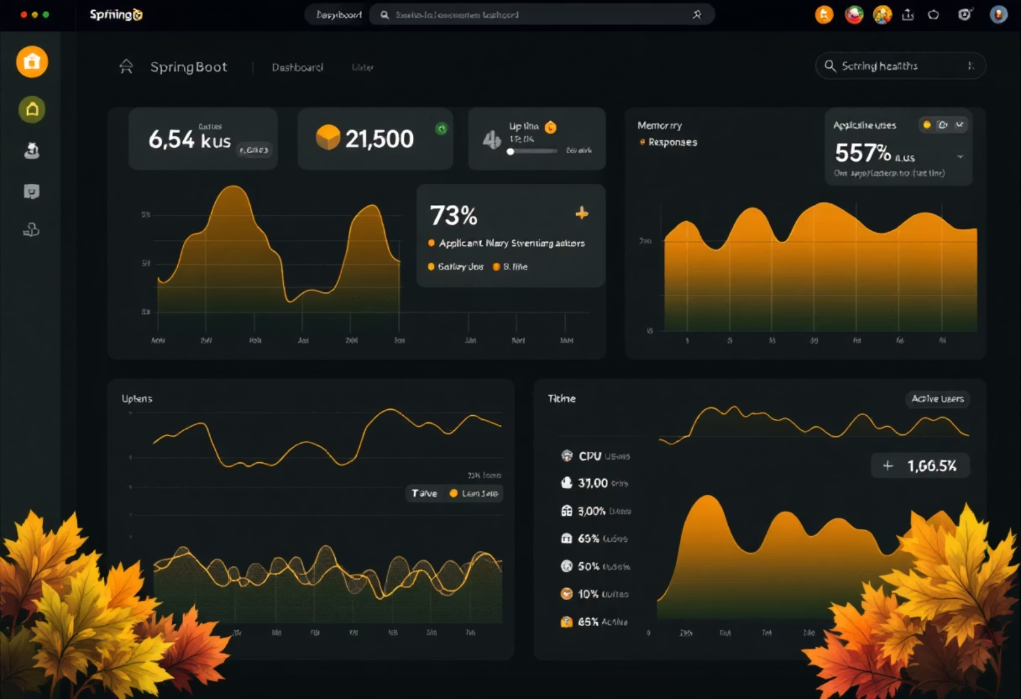
Spring Boot Overview
Key features
Auto-configuration
Embedded servers (Tomcat/Jetty)
Starter dependencies
Production-ready features
80%
Less Boilerplate
Reduce configuration code by up to 80% compared to traditional Spring.
5X
3s
Faster Development
Quick Startup
Build applications up to 5 times faster with pre-configured starters.
Applications typically start in under 3 seconds with embedded servers.

Slide 10
Spring Boot Workflow
Initialize Project
Visit start.spring.io to generate your project structure.
Add Dependencies
Select starter packages for web, data, security, or other features.
Create Main Class
Add @SpringBootApplication annotation to your main class.
Define Components
Create @RestController, @Service classes for your application logic.
Run Application
Execute with "mvn spring-boot:run" or "java -jar yourapp.jar".
References: Spring Documentation, SlideShare

